Slide 1
Regression Project Diamonds Price

Slide 2
1.
Look at the big picture

Slide 3
our model should learn from classic dataset contains the prices and other attributes of almost 54,000 diamonds ,and be able to predict the diamond price .
Features :
price : price in US dollars (\$326--\$18,823)
carat: weight of the diamond (0.2--5.01)
cut :quality of the cut (Fair, Good, Very Good, Premium, Ideal)
color :diamond color, from J (worst) to D (best)
clarity: a measurement of how clear the diamond is (I1 (worst), SI2, SI1, VS2, VS1, VVS2, VVS1, IF (best))
x :length in mm (0--10.74)
y :width in mm (0--58.9)
z :depth in mm (0--31.8)
depth :total depth percentage = z / mean(x, y) = 2 * z / (x + y) (43--79)
table :width of top of diamond relative to widest point (43--95)

Slide 4
2.
Get the data

Slide 5
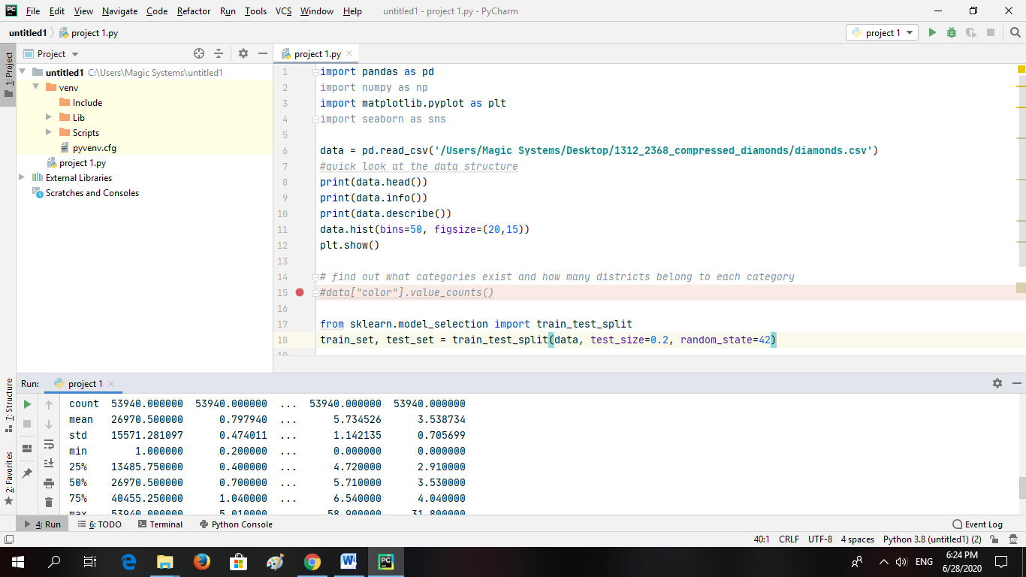
Download data and load it
we download it from Kaggle website :
https://www.kaggle.com/shivam2503/diamonds?fbclid=IwAR1l054zkxlhbQ8tcb7hV4fXfD5vN0LpdolVMeQWDkLTJI_aS9sSNnmvFQw
we put the path of our dataset to read it using pandas:

Slide 6
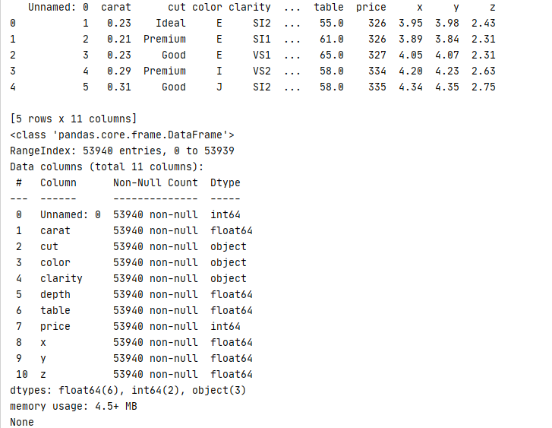
Take a look at the data structure :

Slide 7
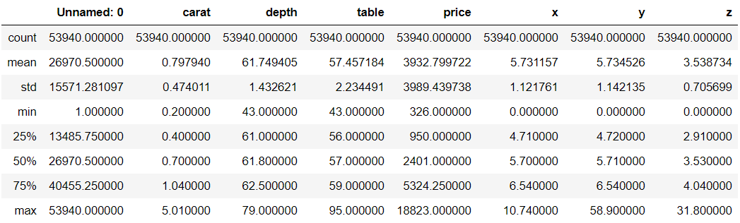
Take a look at the data structure :
Here we can notice that the min values in each x, y and z are equal to 0 which is wrong because they’re length , width and height (dimensions).
here as we can see that we have (53940) instances , 3 features their instances are strings (categorical features) , and the rest are (numerical values).Also, we haven’t any null values .

Slide 8
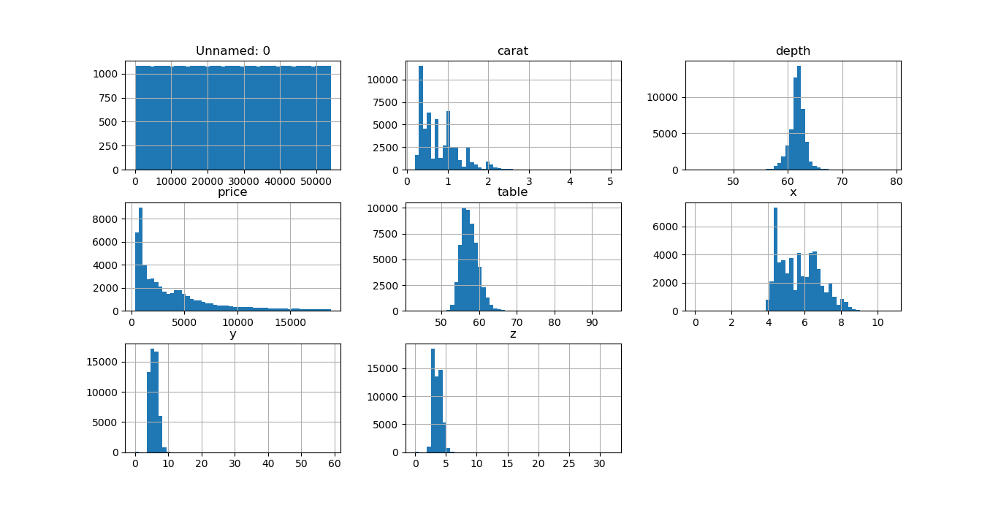
See distributions :
to see the distribution for each column , we used for whole dataframe a (hist) function, which means that we used pandas :

Slide 9
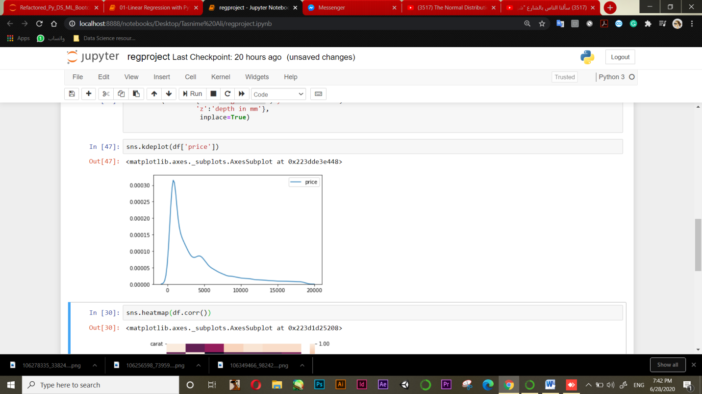
See distributions :
To take a fast look at ‘price’ column distribution (using kde plotting) .Price is always important :
‘price’ column is skewed to the right so, the most of diamond prices are located above the mean.

Slide 10
3. Discover and visualize the data to get insight

Slide 11
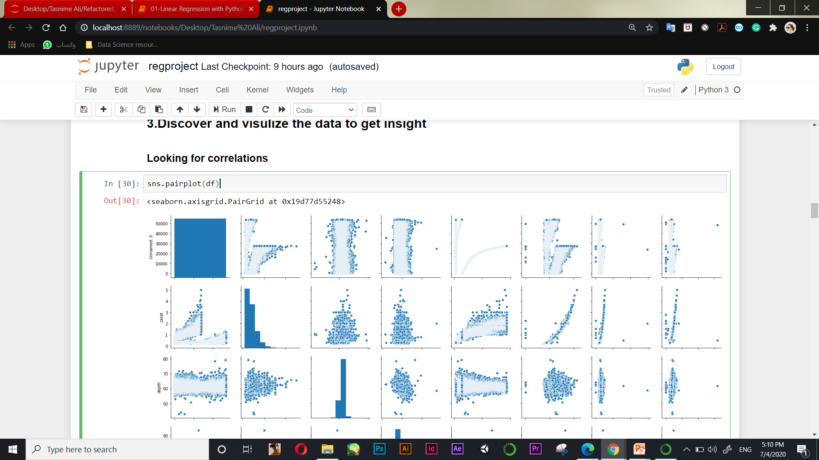
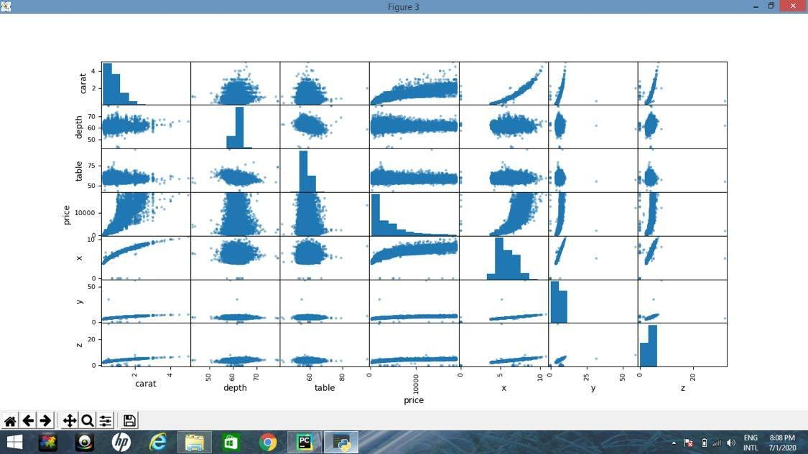
Looking
For
Correlation
(pairplot) :

Slide 12
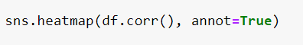
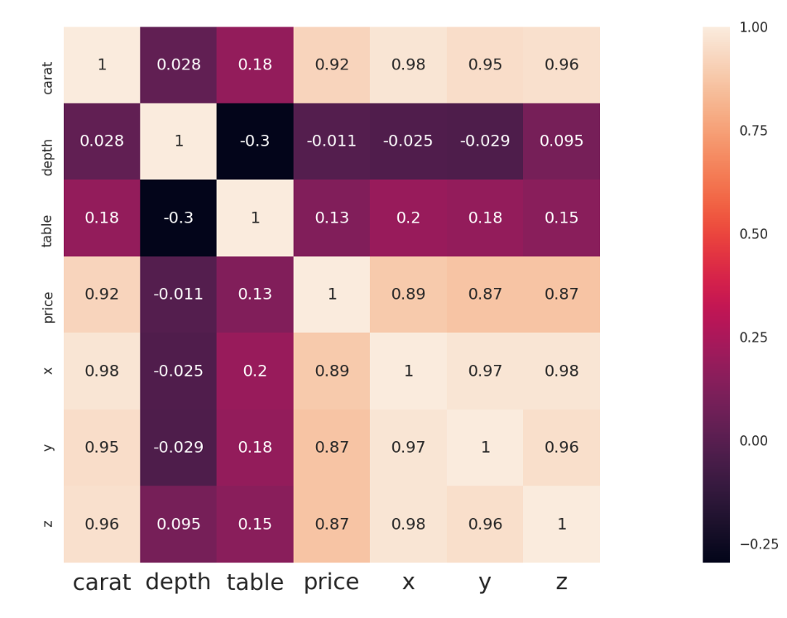
Looking
For Correlation
(heatmap) :
Logically ,the price of diamonds is influenced by the weight of diamond (carat feature). We also see a strong correlation between the features: “carat" and “x“ , ”y” and “z”. Table doesn't have a relation with price.

Slide 13
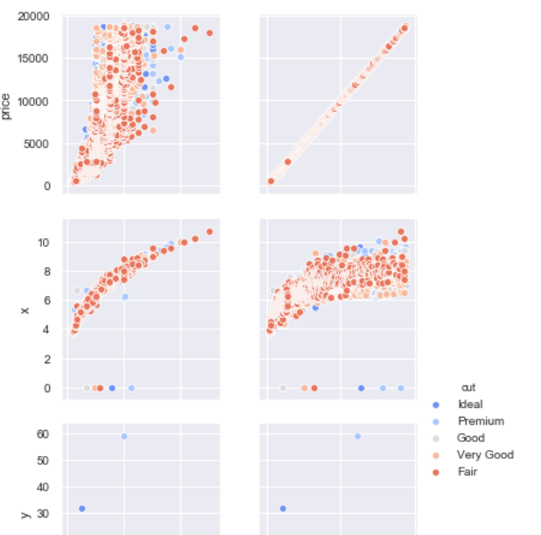
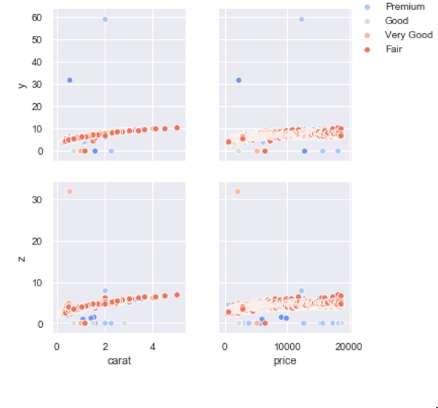
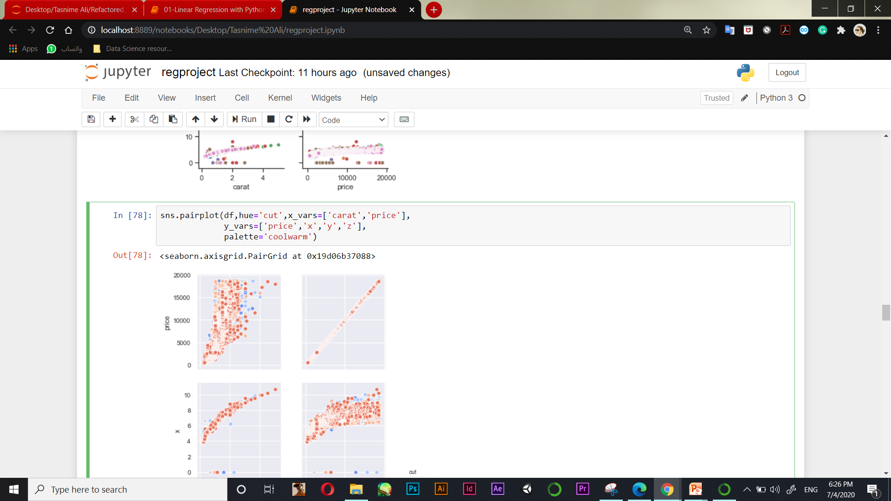
More in pairplot :
Scatter plot helps us understand the association between 2 attributes. Here, we saw that the most important relationship is the price and carat.

Slide 14
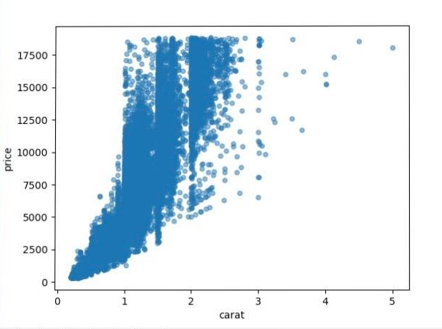
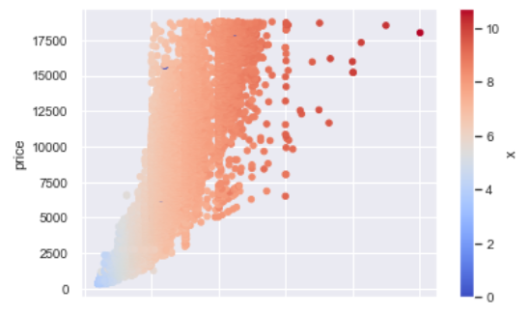
Price vs. Carat
The association here is take an Exponential shape also it’s increasing.
So, price depend on (carat) feature .

Slide 15
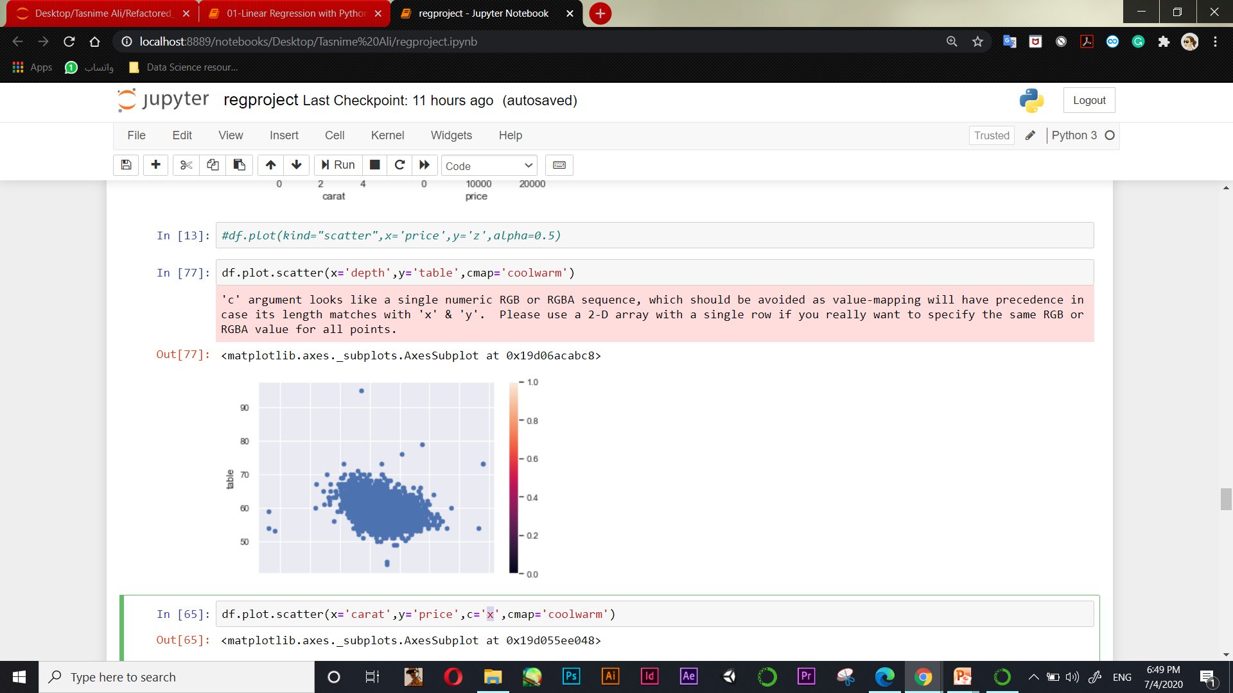
Depth vs. Table
Here, there is no association , they are random values and the correlation value tend to be 0.

Slide 16
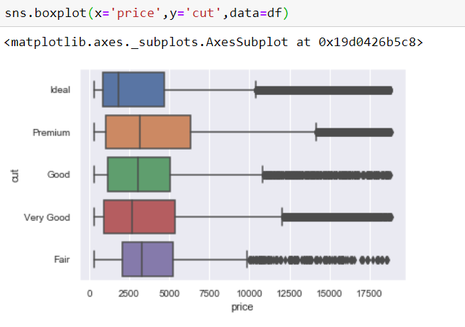

Slide 17
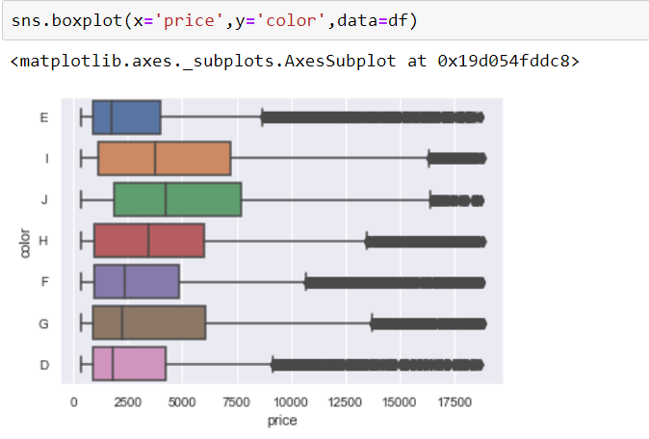

Slide 18
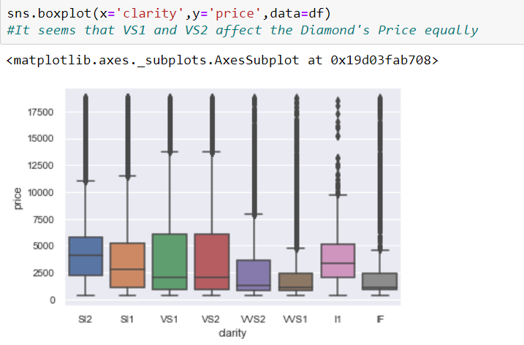

Slide 19
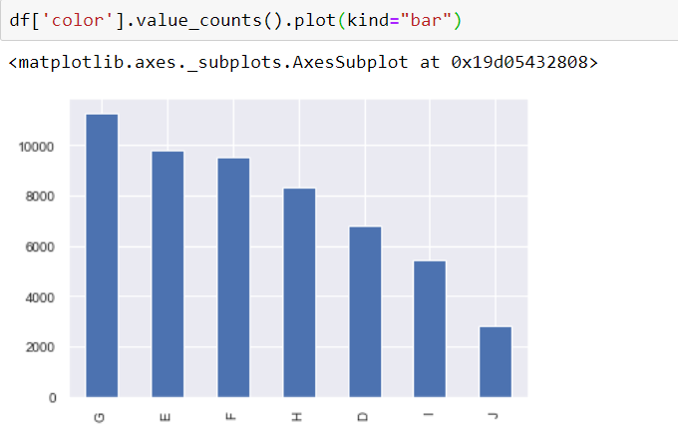

Slide 20
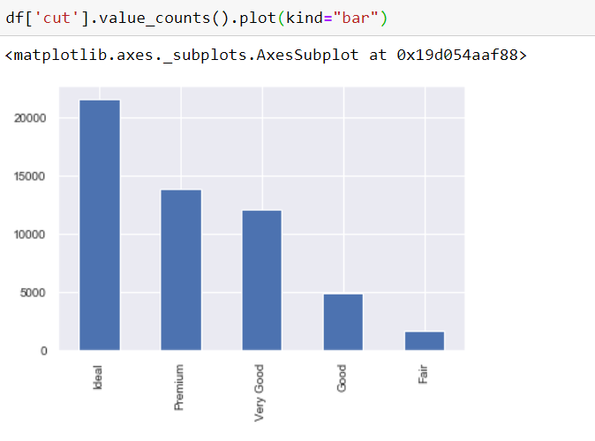

Slide 21
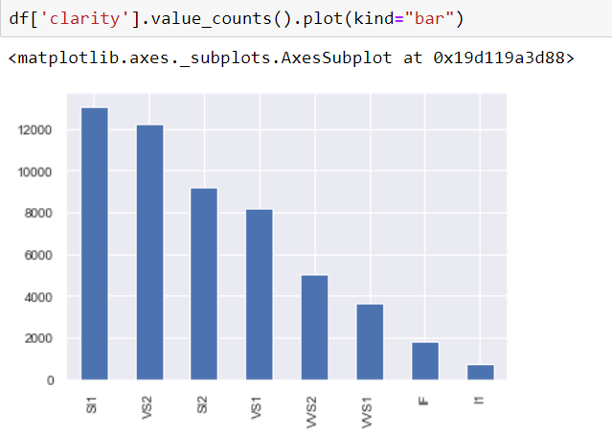

Slide 22
4. Prepare the data for machine learning algorithms

Slide 23
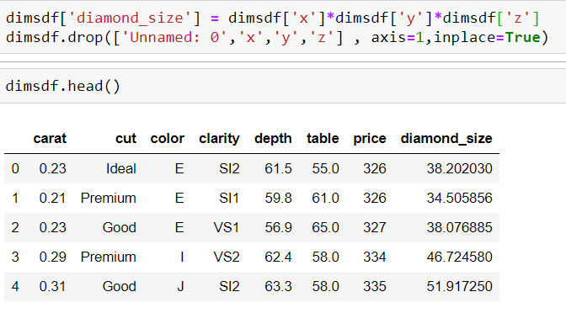
Aggregation column and drop 'Unnamed: 0' col
We realize that x ,y and z columns are dimensions of the diamond so we decided to aggregate them into one column with name ‘diamond_size’ . Also, we delete unnecessary column 'Unnamed: 0' .

Slide 24
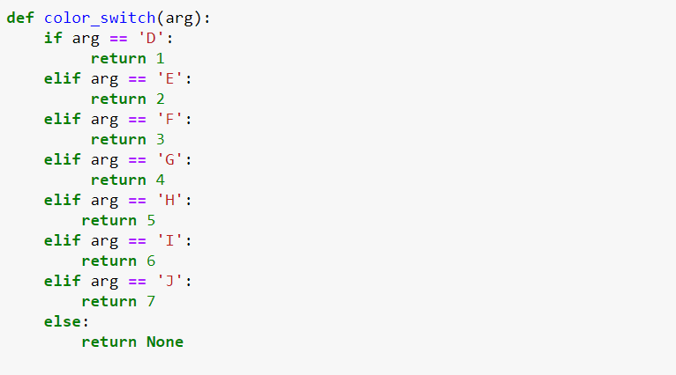
Convert categorical attributes
As long as we have categorical attributes we must to convert them ,so the model can train the data well. Here, we used customized encoder (for every categorical attribute) so we can determine and change the order between categories. (1 is the best)
For ‘color’ column :

Slide 25
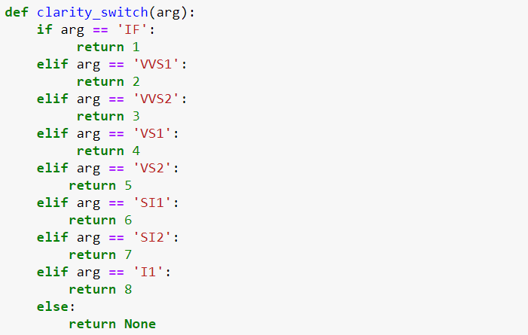
For ‘clarity’ column :

Slide 26
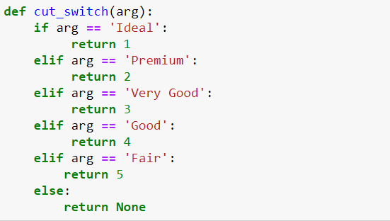
For ‘cut’ column :

Slide 27
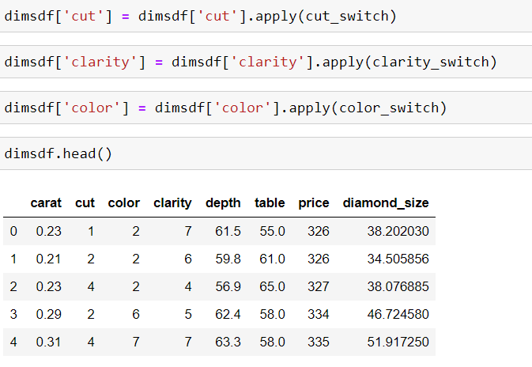
Then we applied the three methods . And here we can notice easily that the categories in each categorical columns are replaced by ordered numbers.

Slide 28
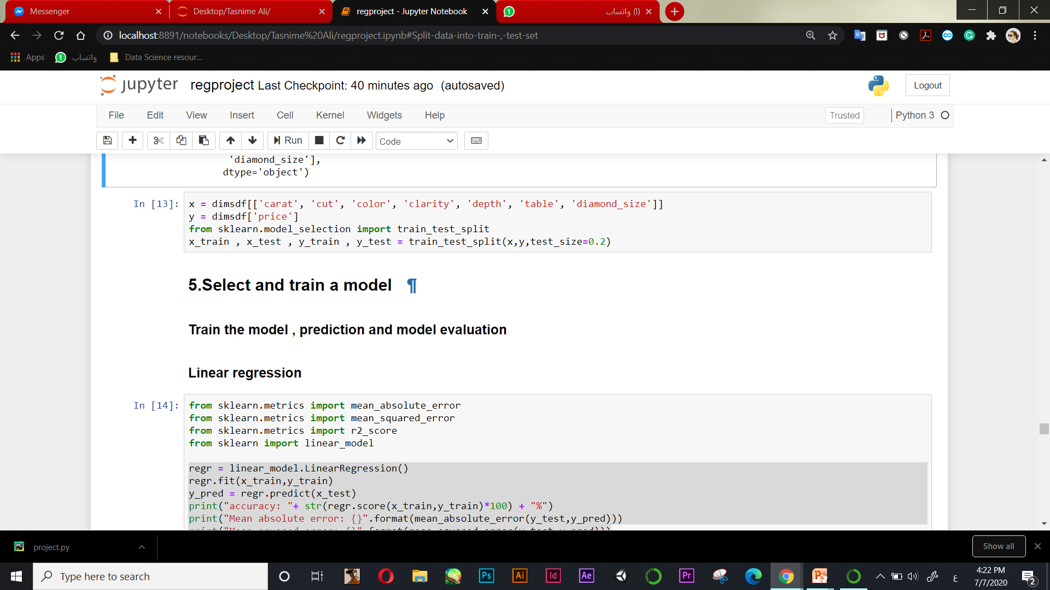
split Data :

Slide 29
5. Select and train a model

Slide 30
We used four regression techniques :
Linear regression
Ridge regression
Lasso regression
Random forest

Slide 31
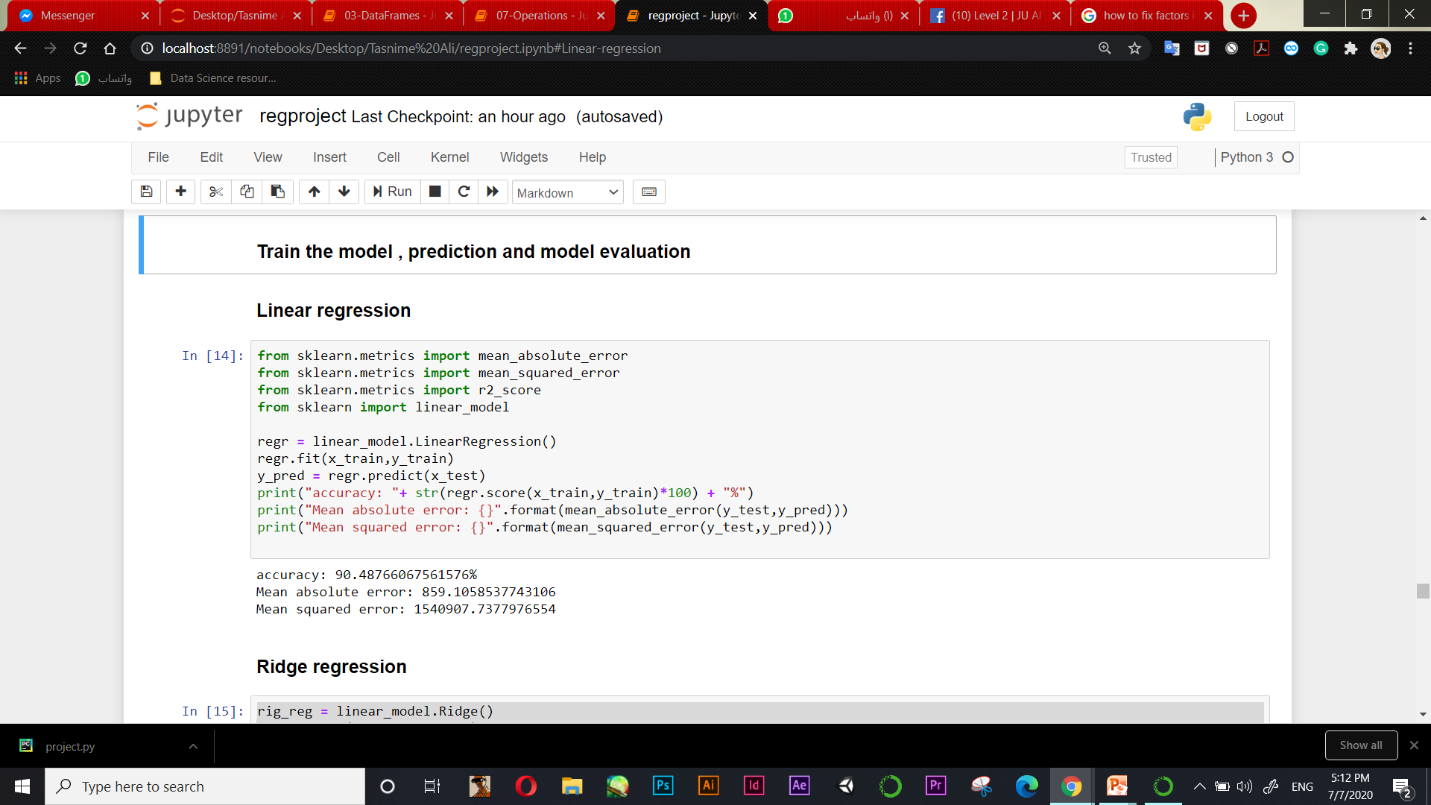
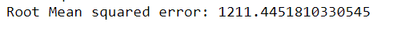
We trained the model , got predictions and evaluate it then compared them at the end as a final step

Slide 32
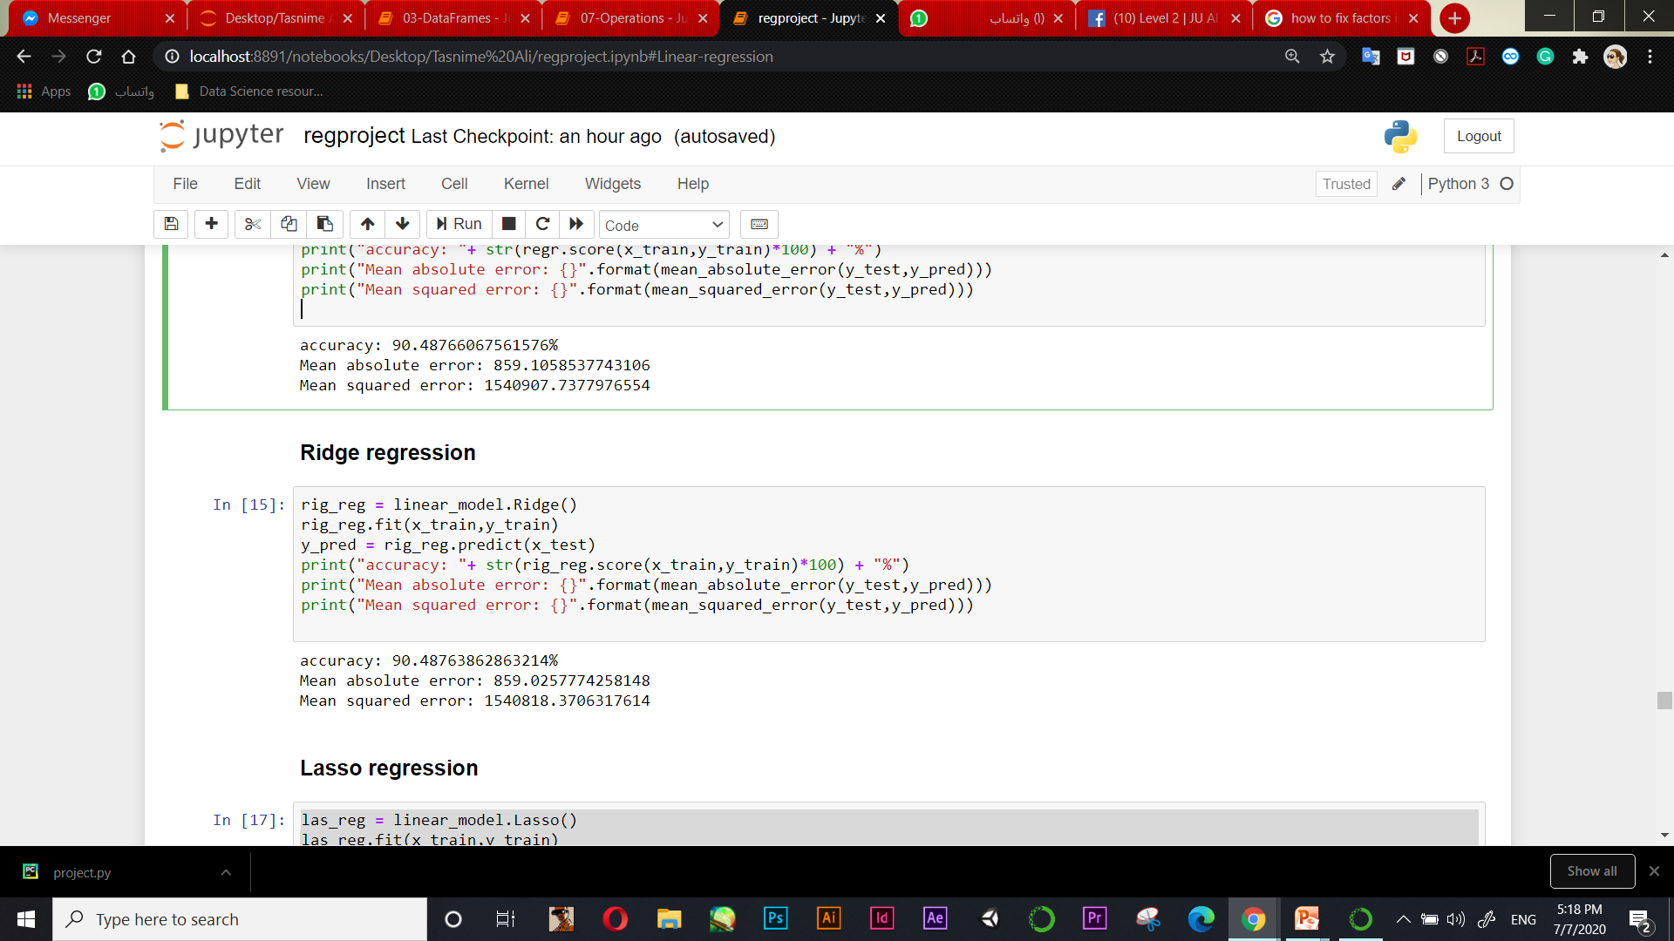
Here , ridge regression gave us less accuracy a little bit from linear regression. Approximately the same error and accuracy

Slide 33
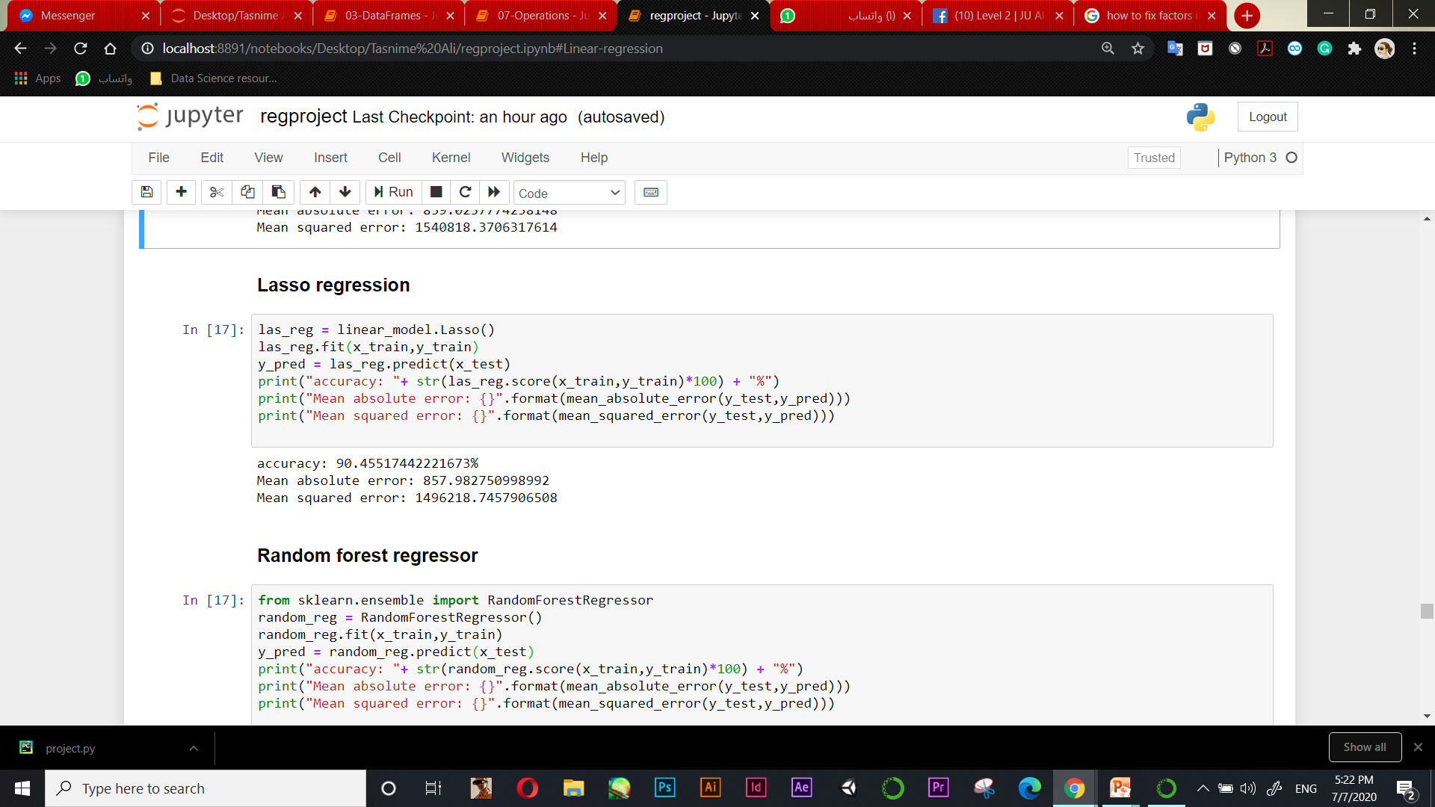
Almost , Lasso regression gave us same accuracy of linear regression. But, less error

Slide 34
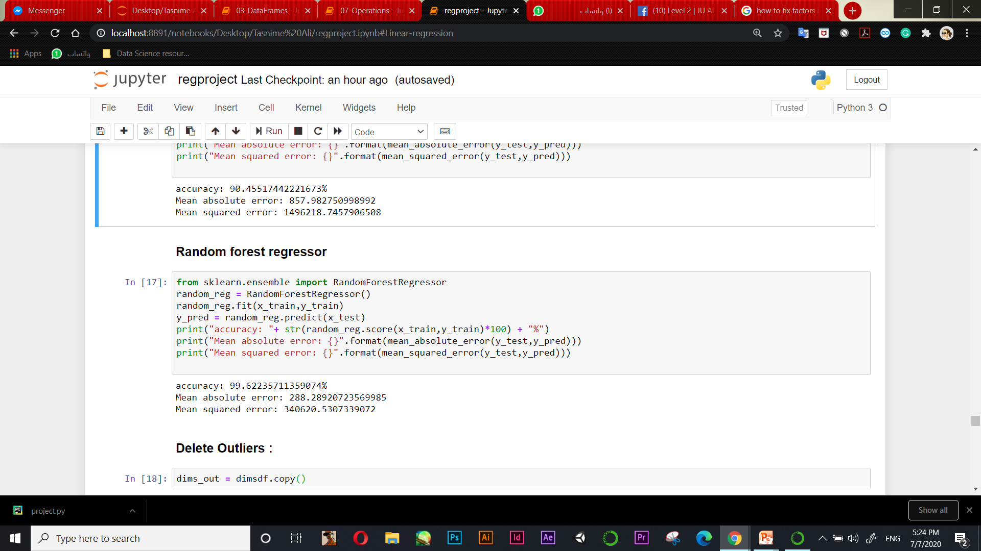
Finally, random forest gave us the best and highest accuracy we would ever get also the least error. So, if we have to consider it as the best model for our training data !!

Slide 35

Outliers ? Let’s try to drop them and see how it will go.

Slide 36
Dropping outliers
We calculated the outliers for each numerical attribute we had and drop them : price, depth, carat, table, diamond_size.

Slide 37
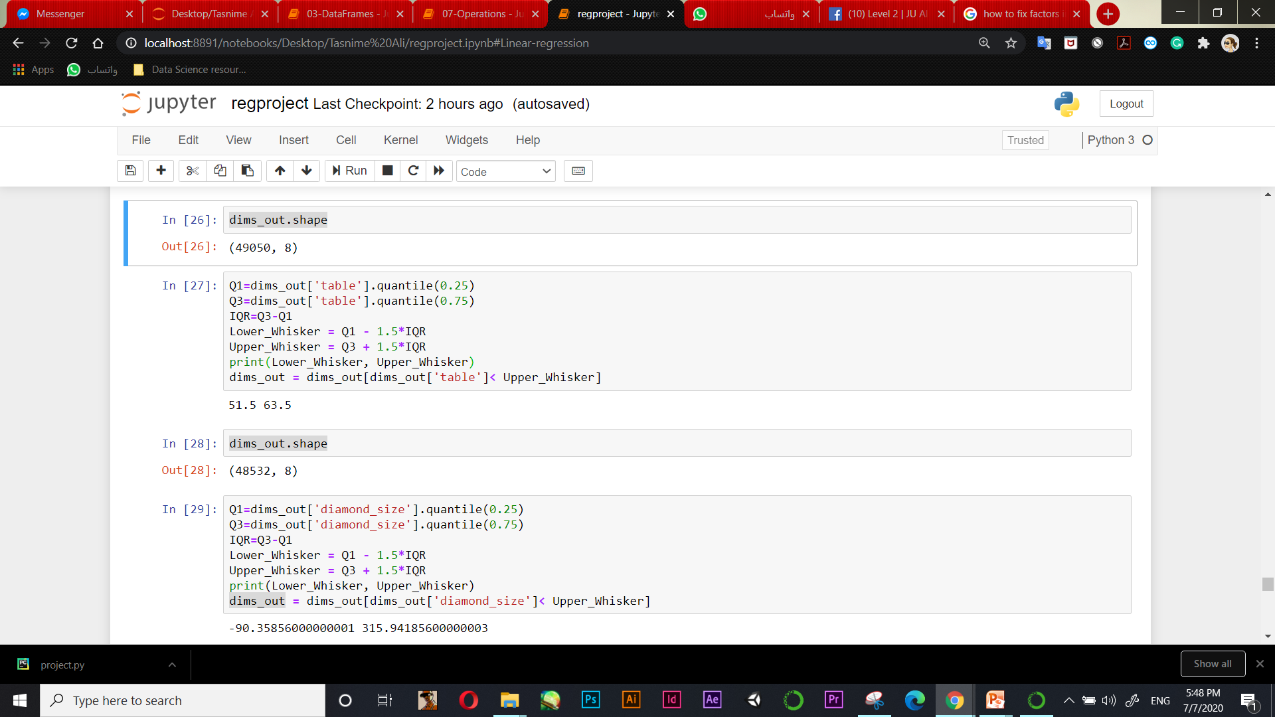
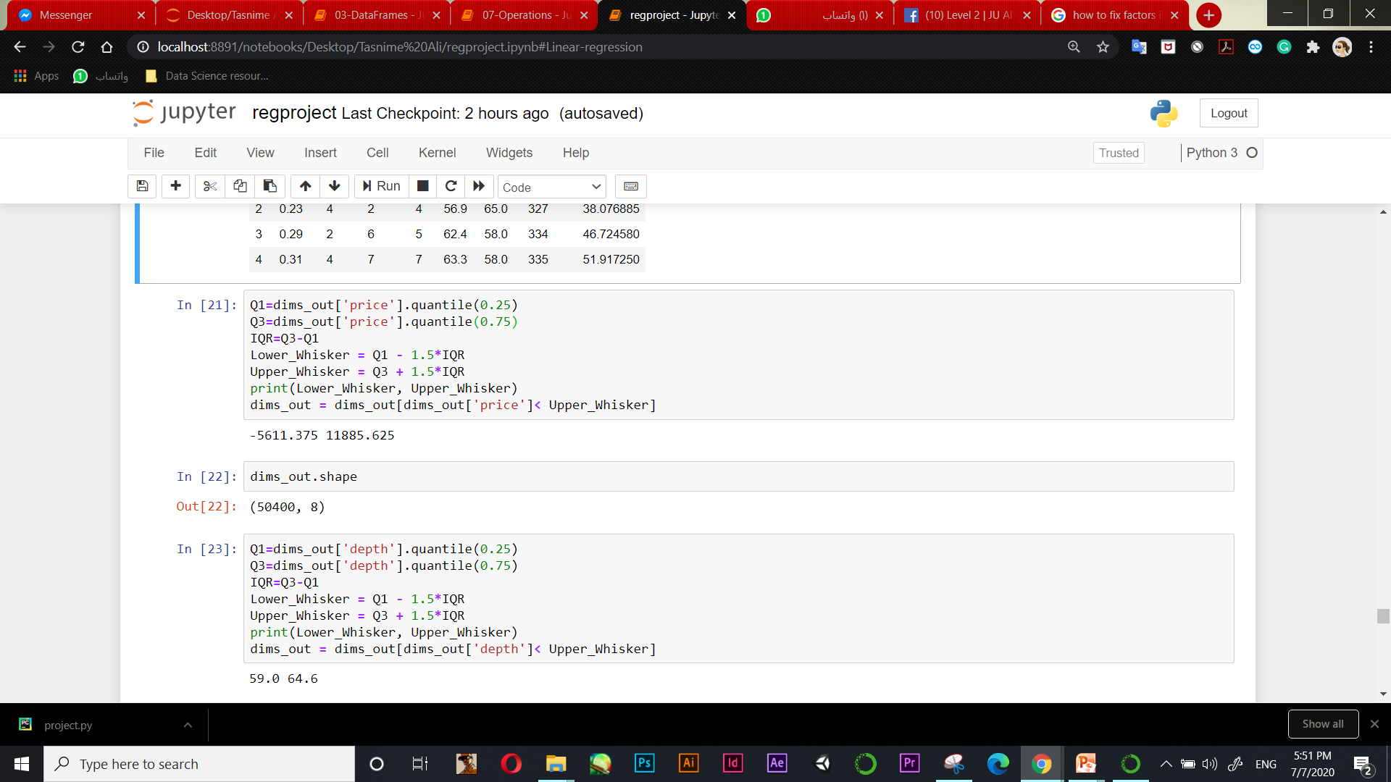

Slide 38


Slide 39
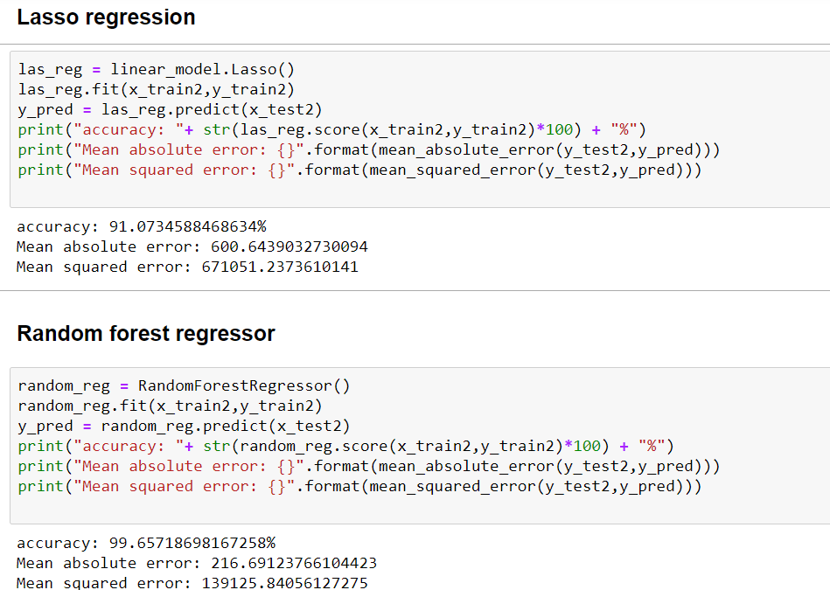

Slide 40
From previous step we can see that the accuracy increased especially on random forest , 0.01% not too much but in some cases it will be much more than that and more useful !.

Slide 41

THANKS!
Any questions?
You can find the code file and the original dataset here :
https://drive.google.com/drive/folders/1S2ilJ9_ln960pDeJrY6aaVkRS5FShsrv?usp=sharing

